Slide 1
Karnaugh Maps (K maps)

Slide 2
What are Karnaugh¹ maps?
Karnaugh maps provide an alternative way of simplifying logic circuits.
Instead of using Boolean algebra simplification techniques, you can transfer logic values from a Boolean statement or a truth table into a Karnaugh map.
The arrangement of 0's and 1's within the map helps you to visualise the logic relationships between the variables and leads directly to a simplified Boolean statement.
¹Named for the American electrical engineer Maurice Karnaugh.

Slide 3

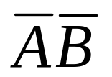
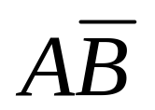



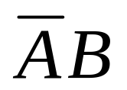

Karnaugh maps
Karnaugh maps, or K-maps, are often used to simplify logic problems with 2, 3 or 4 variables.
Cell = 2^{n} ,where n is a number of variables
For the case of 2 variables, we form a map consisting of 2²=4 cells
as shown in Figure
A
A
A
0
1
0
1
0
1
B
B
B
00 | 10
01 | 11
0
0
0
2
0
1
1
1
1
3
Maxterm
Minterm

Slide 4
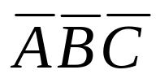
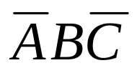
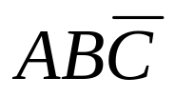
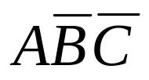
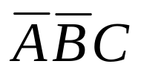
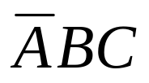

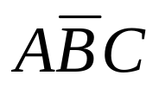
Karnaugh maps
3 variables Karnaugh map
Cell = 2³=8
AB
C
00
01
11
10
0
2
6
4
0
1
3
7
5
1

Slide 5
Karnaugh maps
4 variables Karnaugh map
AB
CD
00
01
11
10
0
4
12
8
00
1
5
13
9
01
3
7
15
11
11
2
6
14
10
10

Slide 6
Karnaugh maps
The Karnaugh map is completed by entering a '1‘(or ‘0’) in each of the appropriate cells.
Within the map, adjacent cells containing 1's (or 0’s) are grouped together in twos, fours, or eights.

Slide 7
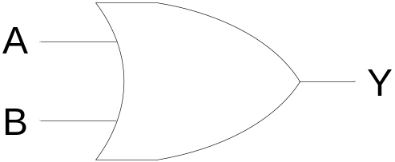
Example
2-variable Karnaugh maps are trivial but can be used to introduce
the methods you need to learn. The map for a 2-input OR gate
looks like this:
A
0
1
B
0
1
A
1
1
1
A | B | Y
0 | 0 | 0
0 | 1 | 1
1 | 0 | 1
1 | 1 | 1
B
A+B

Slide 8
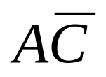

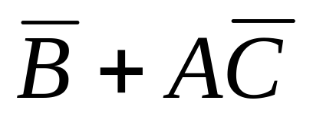
Example
A | B | C | Y
0 | 0 | 0 | 1
0 | 0 | 1 | 1
0 | 1 | 0 | 0
0 | 1 | 1 | 0
1 | 0 | 0 | 1
1 | 0 | 1 | 1
1 | 1 | 0 | 1
1 | 1 | 1 | 0
AB
C
00
01
11
10
0
1
1
1
1
1
1

Slide 9
Exercise
Let us use Karnaugh map to simplify the follow function.
F₁ = m₀+m₂+m₃+m₄+m₅+m₆+m₇
F₂ = m₀+m₁+m₂+m₅+m₇
Answer

Slide 10
Exercise
Given the truth table, find the simplified SOP and POS form.
A | B | C | Y
0 | 0 | 0 | 0
0 | 0 | 1 | 0
0 | 1 | 0 | 0
0 | 1 | 1 | 1
1 | 0 | 0 | 1
1 | 0 | 1 | 1
1 | 1 | 0 | 1
1 | 1 | 1 | 1

Slide 11
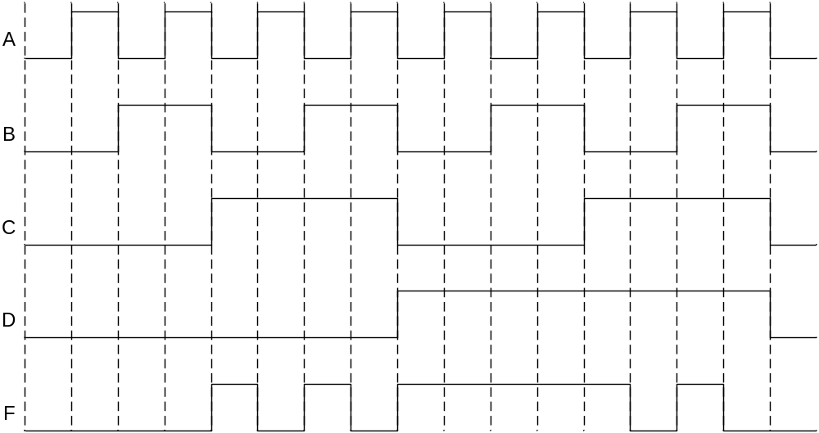
Exercise
Design two-level NAND-gate logic circuit from the follow timing diagram.

Slide 12
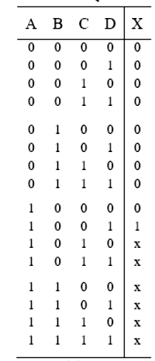
Don’t care term
AB
CD
00
01
11
10
 |  | X
 |  | X | 1
 |  | X | X
 |  | X | X
00
01
11
10
AD

Slide 13
Exercise
Design logic circuit that convert a 4-bits binary code to Excess-3 code
A | B | C | D | W | X | Y | Z
0 | 0 | 0 | 0 | 0 | 0 | 1 | 1
0 | 0 | 0 | 1 | 0 | 1 | 0 | 0
0 | 0 | 1 | 0 | 0 | 1 | 0 | 1
0 | 0 | 1 | 1 | 0 | 1 | 1 | 0
0 | 1 | 0 | 0 | 0 | 1 | 1 | 1
0 | 1 | 0 | 1 | 1 | 0 | 0 | 0
0 | 1 | 1 | 0 | 1 | 0 | 0 | 1
0 | 1 | 1 | 1 | 1 | 0 | 1 | 0
1 | 0 | 0 | 0 | 1 | 0 | 1 | 1
1 | 0 | 0 | 1 | 1 | 1 | 0 | 0
1 | 0 | 1 | 0 | x | x | x | x
1 | 0 | 1 | 1 | x | x | x | x
1 | 1 | 0 | 0 | x | x | x | x
1 | 1 | 0 | 1 | x | x | x | x
1 1 | 1 1 | 1 1 | 0 1 | x X | X X | X x | X x

